Slide 1
Lipid Digestion and Absorption

Slide 2
Quiz Question #1
Where does the majority of lipase activity occur?
Mouth and esophagus
Stomach
Small Intestine
Large Intestine

Slide 3
Quiz Question #2
What do bile-salt containing micelles have the best affinity for?
Cholesterol esters
Monoacylglycerol
Diacylglycerol
Triacylglycerol

Slide 4
Quiz Question #3
What tissue synthesizes chylomicrons
Liver cells
Bile ducts
Enterocytes
Adipocytes

Slide 5
Quiz #4
Which of the following is not a cholesterol lowering nutrient?
Monounsaturated fats
Trans Fats
Fiber
Phytosterols

Slide 6
Midterm Exam
Average 89.5

Slide 7
Grading Rubric Update
Range | Projected Grade
87+ | A
80-87 | A-
75-80 | B+
70-75 | B
65-70 | B-

Slide 8
CRLT Review
Next week (Monday)
Last 30 minutes of class
Your feedback is very important so think about what you expected, what you learned, and what could be improved

Slide 9
Lipid Digestion and Absorption Learning Objectives
Describe the role of lingual lipase on lipid digestion in the stomach
Describe gastric lipase and emulsification processes that occur in the stomach
Describe pancreatic lipase and emulsification processes in the small intestine
Understand the role of bile salts in the formation of micelles
Identify the transport mechanisms of lipids across the apical and basolateral membranes
Describe reesterification processes in the enterocyte
Understand the formation and fate of the chylomicron and its role in lipid transportation
Describe what happens following the breakdown of chylomicron in circulation

Slide 10
Dietary Lipids
Triacylglycerols
Main lipid of diets
Provides essential FAs (polyunsaturated)
Average daily dietary intake:
Men: 95g
Women: 65g
Sterols (cholesterol) and phospholipids
Cholesterol average intake 300 mg/day (animal products)
1-2 g/day of phospholipids
NHANES 2000-2006

Slide 11
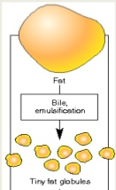
Lipids
Hydrophobic molecules -- challenge to travel through aqueous environments
Digestive mechanisms required to increases solubility of lipid particle
Mechanical forces - emulsification
Bile salts
Emulsification processes
Stability factor
Fat
Emulsification
Fat Globules

Slide 12
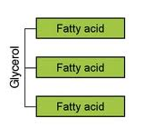
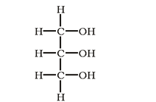
Triacylglycerol Digestion: Mouth and Stomach
Lingual lipase
Glands under tongue
Stimulated by neural factors, high fat diets, mechanical motion in mouth
Works in low pH (stomach), very little digestion occurring in mouth
Specific to:
Short-chained FAs on triacylglycerols
sn-3 of glycerol
Produces diacylglycerols and free FAs
sn-1
sn-2
sn-3
Glycerol

Slide 13
What do you think?
Can we taste fatty acids? What about triglycerides?
Notes:
Basic tastses are umami, sweet, bitter, sour, salt

Slide 14
Gastric Lipase in the Stomach
Gastric lipase
Secreted by chief cells
Prefers short-chain fatty acids
Works best in low pH (stomach)
But can continue to work in upper small intestine
Specific to sn-1 and-3 of glycerol
Produces di- and monoacylglycerols and free FAs
sn-1
sn-2
sn-3

Slide 15
Triacylglycerol Digestion: Stomach
Emulsification – breaking large lipids into smaller lipids
Starts in stomach
Peristalsis
Wear and tear through sphincter
Fat
Emulsification
Fat Globules

Slide 16
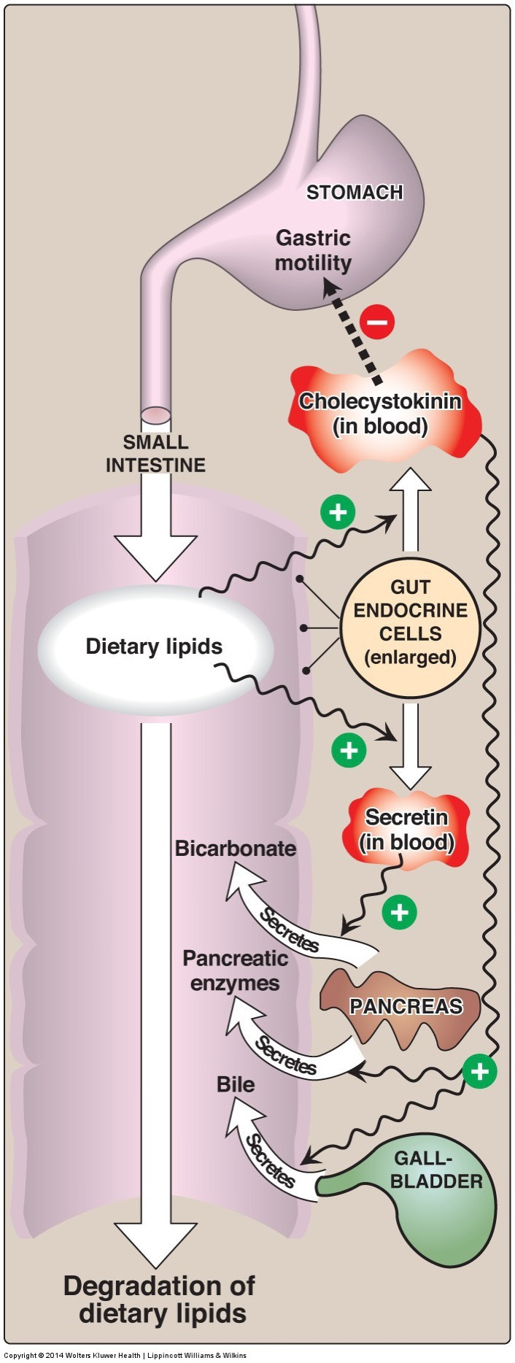
Triacylglycerol Digestion: Small Intestine
Lipid droplets and digestive products enter small intestine
90% of lipid digestion occurs in small intestine
Efficient emulsifiers – bile salts
Allows for greater availability of lipases to reach triacylglycerides
Different lipase (pancreatic lipase) – require less acidic environment

Slide 17
Triacylglycerol Digestion: Role of CCK
CCK activated by peptides and fats in the small intestine and released from enteroendocrine cells (I Cells)
Also stimulated by paracrine signalign from enterocytes and the parasymathetic nervous system
CCK stimulates release of:
Bicarbonate and lipases from pancreas – part of pancreatic juice
Bile from gallbladder
Notes:
Parasympathetic (rest and digest or feed and breed)

Slide 18
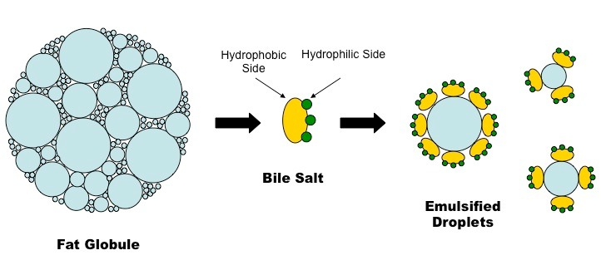
Bile
Notes:
Conjugated with taurine

Slide 19
Bile Salts and Intrahepatic Portal Circulation
Cholesterol is converted into bile salts and stored in gall bladder
CCK promotes Bile Release
Contraction of gallbladder
Relaxation of Sphincter of Oddi
~30g per day released per day, 95% of it is recovered in terminal illeum
Shphincter of Oddi

Slide 20
What kind of transport mechanism do you think is needed to fill the gall bladder?
Diffusion
Active Transport
Passive Transport

Slide 21
ABCG5/8 and Sitosterolemia
Normally removal of plant sterols from the small intestine is is very efficient (95%)

Slide 22
Other problems due to bile salt defects
Cholestasis
Reduced flow of bile
Caused by hepatitis, liver disease, biliary cirrhosis, bile stones or blockages
Poor absorption of fats, vitamins (D/E/K)
Gallstones
Crystalization of bile salts in gallbladder
Associated with too much cholesterol in diet
Cholecystis
Inflammation of gallbladder
Commonly caused by gallstones

Slide 23
Pancreatic Lipase Requires Colipase
Pro-colipase secreted by pancreas
Activated by trypsin to colipase (co-enzyme for pancreatic lipase) in small intestine
Colipase required for pancreatic lipase to recognize and bind substrates
Colipase allows pancreatic lipase to bind to lipid droplet = hydrolytic action on droplet
Lipase or Colipase deficiency – results in lipid malabsorption

Slide 24
Orlistat (aka Xenical)
Jarl S, Mark N. XENical in the Prevention of Diabetes in Obese Subjects ( XENDOS ) Study. Diabetes Care 2004; 27:155–61.
Notes:
4-6lb in other studies.
Steatorrhea
Contraindications for malabsorbtion, reduced gallbladder function and pancreatic diseases

Slide 25
Triacylglycerol Digestion: Small Intestine
Pancreatic lipase activity
–Specific to sn-1 and -3 FA of triacylglycerol
- Longer-chained FA
Products include:
Di- and monoacylglycerols
Free fatty acids
With peristaltic agitation of stabilized, bile-surrounded droplet and chemical enzymatic action = efficient emulsification
sn-1
sn-2
sn-3

Slide 26
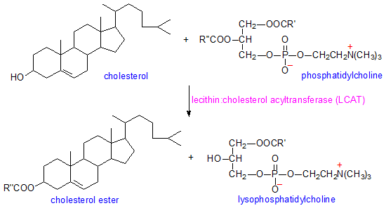
Cholesterol Digestion
Sterol esterase: cleaves fatty acid from cholesterol ester
In small intestine
Esterase
Esterified cholesterol
Cholesterol + Free FA
Fatty acid

Slide 27
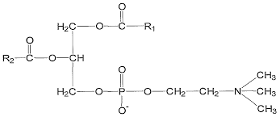
Phospholipid Digestion
Pancreatic phospholipase
Phospholipase A2 specific to sn-2 of phosphatidylcholine
Most predominate dietary phospholipid is phosphatidylcholine
Phospholipase A2
Phosphatidylcholine
lysophosphatidylcholine + Free FAs
Fatty acid
Fatty acid

Slide 28
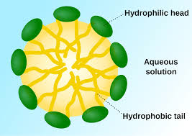
Small Intestine End Products
Products in small intestine:
Fatty acids
Mono- and diacylglycerols
Cholesterol
Phospholipids
Micelle Formation
Micelle

Slide 29
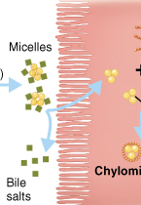
Absorption: Small Intestinal Enterocytes
Lipid contents diffuse out of micelle
Cross apical membrane by diffusion (concentration gradient), passive and active transport mechanisms
Bile salts are either exported from enterocyte or removed during uptake

Slide 30
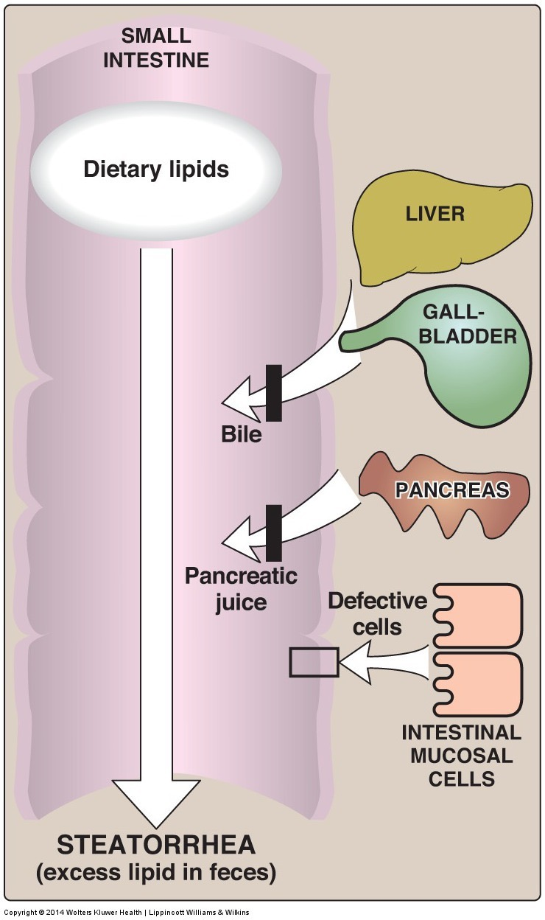
Steatorrhea
Think of some things that could cause excess lipid in the feces

Slide 31
What happens in the enterocyte?

Slide 32
Absorption: Small Intestine
Digested lipids in enterocyte
FAs with <12 carbons are more soluble
Diffuse into circulation → liver
Transported to liver by albumin
Small and medium chain fatty acids
FA with ≥12 carbons reform (re-esterification) into:
Tri, di-, and monoacylglycerols
Cholesterol esters

Slide 33
What would be the benefit of breaking down, then re-synthesizing lipids in the enterocyte
Try to think of a way to explain this in an analogy
Think of when that analogy breaks down

Slide 34
Chylomicrons are lipoprotein particles
Re-esterfied lipids and long-chained fatty acids form a chylomicron
Transporter of re-esterfied lipids and long-chained fatty acids out of small intestine
Chylomicron gains a protein and phospholipid coat for solubility – thus considered to be a lipoprotein

Slide 35
Apolipoproteins
Apolipoprotein: protein that stabilize lipid particle in aqueous environments
Named by apo + series of letters (A-E) + number
Examples: apoB-100, apoE, apoB-48, etc.
Apolipoproteins have other physiological functions important for lipid metabolism:
Stimulate enzymatic reactions
Regulate metabolic functions such as lipase activity
Specificity towards receptors, targets lipoproteins to particular tissues
LDL contains apo100
apo100 specific to the LDL Receptor (LDLR)

Slide 36
Role of Apolipoproteins and LDL in Triglyceride Transport
Reiner Ž. Hypertriglyceridaemia and risk of coronary artery disease. Nat Rev Cardiol; 2017; 14: 401–11. doi: 10.1038/nrcardio.2017.31.

Slide 37
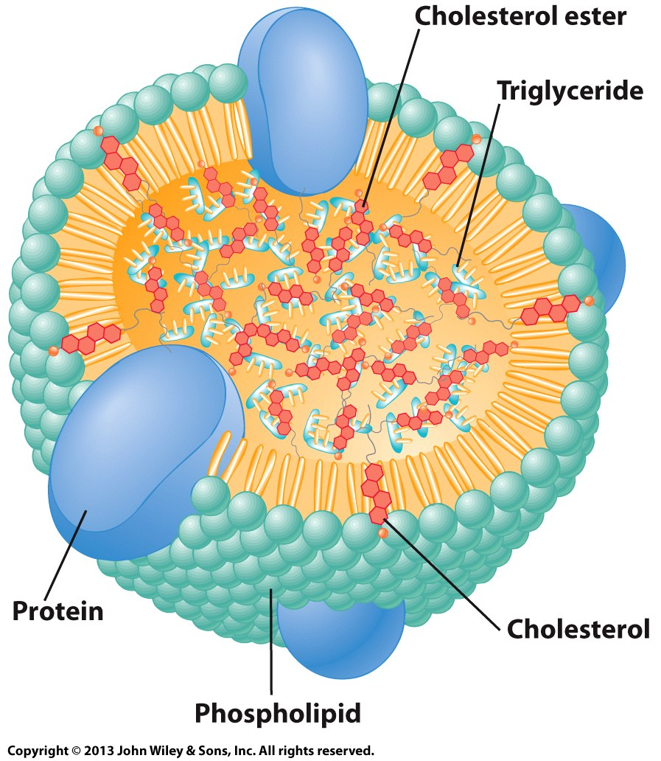
Chylomicron composition
Apolipoprotein A-1
Chylomicron lipid arrangement:
Hydrophobic lipids in center of molecule
Hydrophilic (proteins and phosphate groups) situated at surface
Specific apolipoproteins in chylomicrons are ApoA1 and ApoB48
Apolipoprotein B-48

Slide 38
Apoproteins
These proteins facilitate lipid solubilization and help to maintain the structural integrity of lipoproteins.
Type Association Function
B48 Chylomicron Carry chol. esters, Lacks LDL receptor binding domain
B100 VLDL,IDL,LDL Binds LDL receptor
C-II Chyl. VLDL, IDL, HDL Activates LPL
C-III Chyl. VLDL, IDL, HDL Inhibits LPL
E Chyl. Remnant, VLDL, IDL, HDL Binds LDL receptor
A-1 HDL/Chylomicron LCAT activator (lecithin:cholesterol acyltransferase)
Slides used with permission from Theresa Han-Markey
Notes:
LPL- Lipoprotein lipase
LCAT- an enzyme that converts free cholesterol into cholesteryl ester (a more hydrophobic form of cholesterol), which is then sequestered into the core of a lipoprotein particle

Slide 39
Chylomicron – Lipid Transportation
Chylomicrons too large to enter capillaries
Exits basolateral membrane into lymphatic circulation
Exocytosed through basolateral membrane via secretory vesicle
Chylomicron bypass liver and enter circulation via lymph system
In circulation: chylomicron picks up additional apolipoproteins

Slide 40
What would an impairment in enterocyte triglyceride synthesis affect?
Long Chain Fatty Acid Absorption
Medium Chain Fatty Acid Absorption
Short Chain Fatty Acid Absorption
All of the above
None of the above

Slide 41
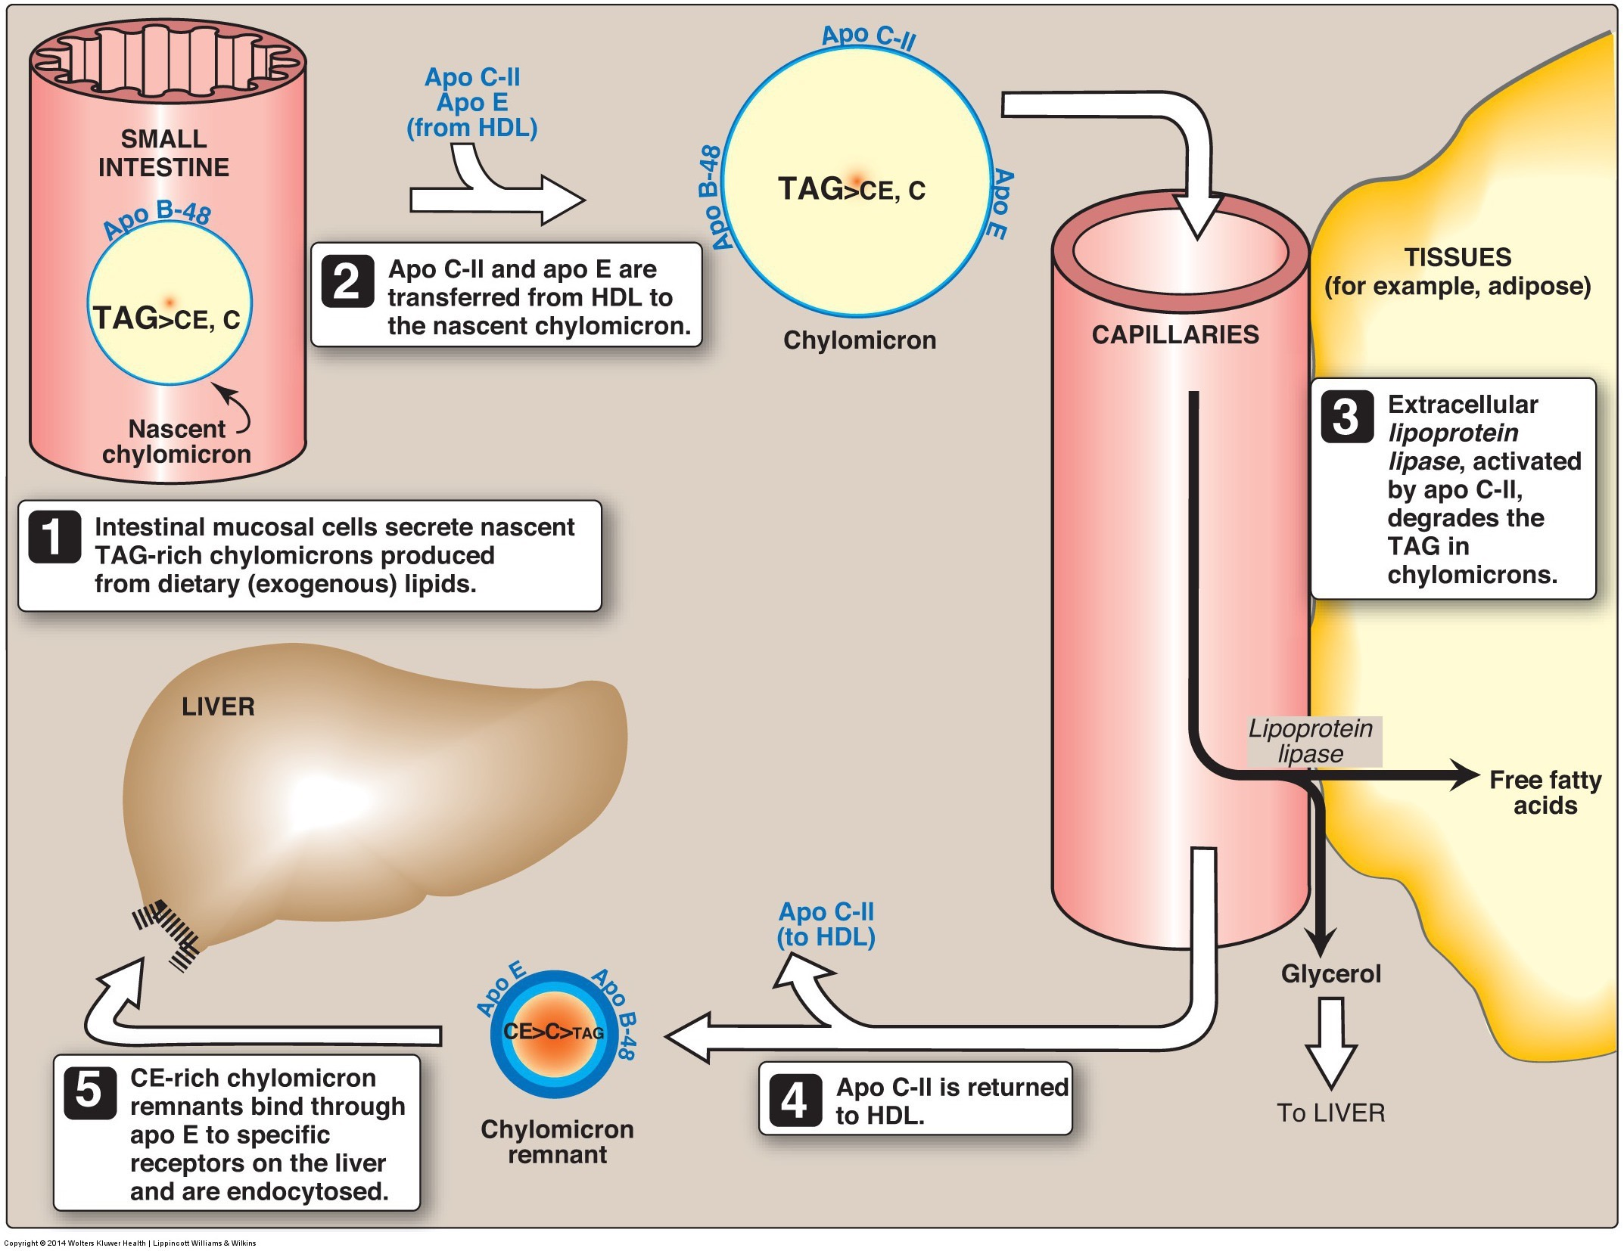
Chylomicrons Transport Lipids to Tissues
Chylomicrons travel mainly to adipose tissue and muscle
Lipoprotein lipase (LPL) – enzyme in endothelial membrane of adipose and muscle tissues
Chylomicron remnant travels to liver
Notes:
ApoC helps LPL recognize lipids
Hydrolyzes FA from mono-, di-, and triacylglycerols of chylomicron
Fatty acids enter tissues
Product of lipoprotein lipase: Chylomicron remnant – rich in cholesterol

Slide 42
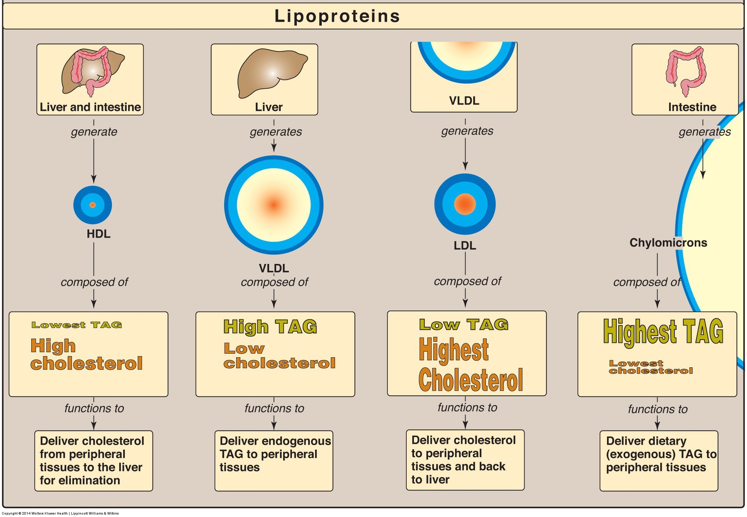
Other Apolipoproteins

Slide 43
Summary
Lipases are enzymes that work to breakdown large lipids to smaller lipids
Lingual/gastric (low pH to function) and pancreatic (higher pH to function) lipase
Lipases, bile, and mechanical forces efficiently emulsify lipids
Micelles made of digested lipids and bile salts form at the brush border
Aides in successful absorption across apical membrane of enterocyte by stabilizing in aqueous environment
Digested lipids (>10 FA HC chain) are re-esterfied in enterocyte
Digested lipids form chylomicron - contains apolipoproteins and phospholipids – before being absorbed across basolateral membrane
Enter lymph system
Transportation of chylomicron results in chylomicron remnant which is cholesterol rich
Chylomicron remnant continues transporting cholesterol to tissue
Eventual formation of IDL, LDL, and HDL

